Slide 1
Forward Propagation
Images are fed into the input layer in the form of numbers.
These numerical values denote the intensity of pixels in the image.
The neurons in the hidden layers apply a few mathematical operations on these values (which we will discuss later in this article).
In order to perform these mathematical operations, there are certain parameter values that are randomly initialized.
Post these mathematical operations at the hidden layer, the result is sent to the output layer which generates the final prediction.

Slide 2
BackPropogation
Once the output is generated, the next step is to compare the output with the actual value.
Based on the final output, and how close or far this is from the actual value (error), the values of the parameters are updated.
The forward propagation process is repeated using the updated parameter values and new outputs are generated.

Slide 3
What is CNN ?
CNNs have become fundamental in computer vision tasks such as image classification, object detection, and segmentation.
In deep learning, a convolutional neural network (CNN/ConvNet) is a class of deep neural networks, most commonly applied to analyze visual imagery.
The CNNarchitecture uses a special technique called Convolution instead of relying solely on matrix multiplications like traditional neural networks.
Convolutional networks use a process called convolution, which combines two functions to show how one changes the shape of the other.
The bottom line is that the role of the convolutional networks is to reduce the images into a form that is easier to process, without losing features that are critical for getting a good prediction.

Slide 4

What is CNN ?

Slide 5
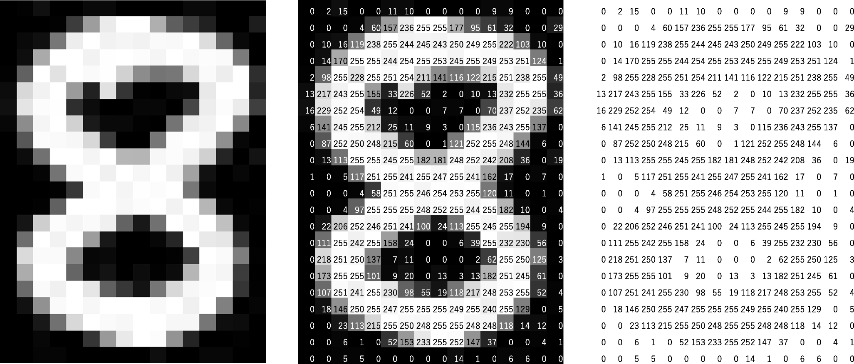
Gray Scale Image

Slide 6
Image Representation
2d Matrix of shape :
50 X 50
Each Element Represents the Pixel Intensity
Range: 0 to 255
Image with Size : 50 X 50

Slide 7
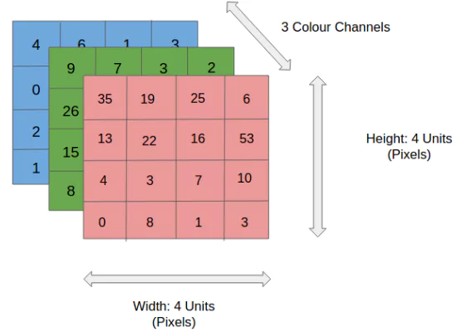
Color Images
Array : 50 X 50 X 3

Slide 8
Convolution Layer
The convolutional neuron performs an elementwise dot product with a unique kernel(filter) and the output of the previous layer’s corresponding neuron.
This will yield as many intermediate results as there are unique kernels(filters).
The convolutional neuron is the result of all of the intermediate results summed together with the learned bias.
An image is a big array of pixel activation values. These arrays are followed by more arrays of (initially random) values – the weights – that we call a “filter” or “kernel”.
A convolutional layer is an element-wise multiplication between these pixel values and the filter weights – which are then summed.

Slide 9
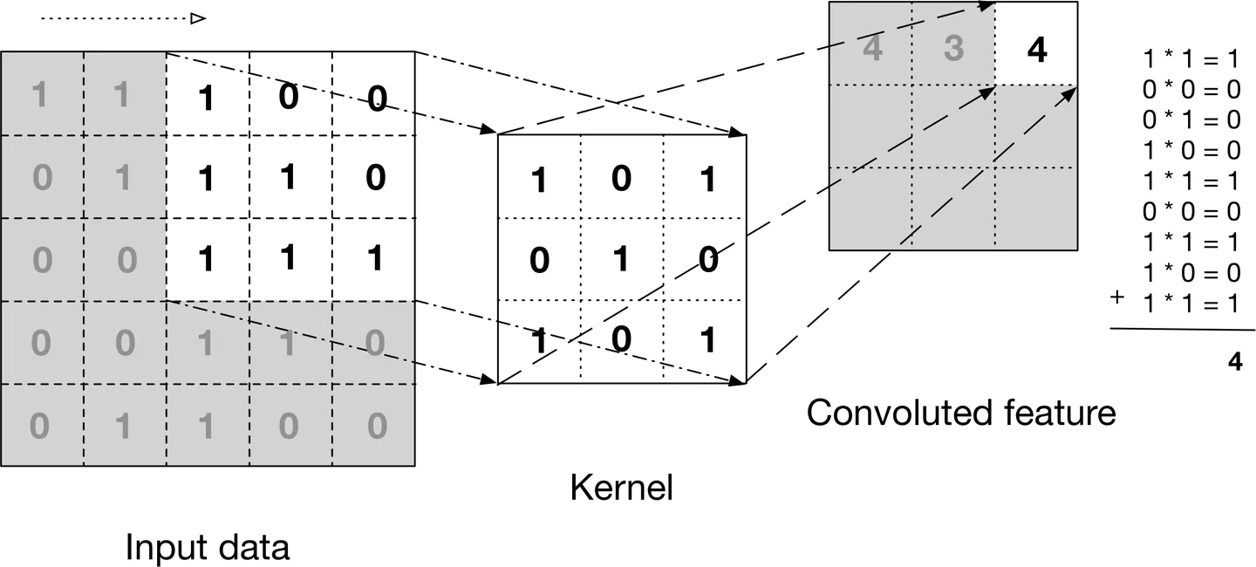
Convolution Operation
We take a filter/kernel(3×3 matrix) and apply it to the input image to get the convolved feature. This convolved feature is passed on to the next layer.

Slide 10
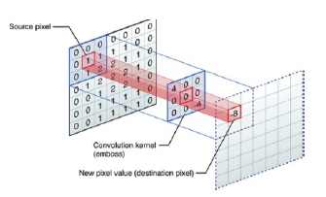
Convolution Operation

Slide 11

Convolution Operation

Slide 12

Convolution Operation(color image)

Slide 13
Convolution Operation
We don’t return a single scalar value because we perform many of these operations on each layer.
For each convolutional layer, the filter slides (or “convolves”) over the previous layer’s matrix (or image) from left-to-right and top-to-bottom.
The filter can detect specific local features such as edges, shapes, and textures by sliding over the image.
The convolution output is called a “feature map” or “activation map” thanks to the representation or activations of detected features from the input layer.

Slide 14
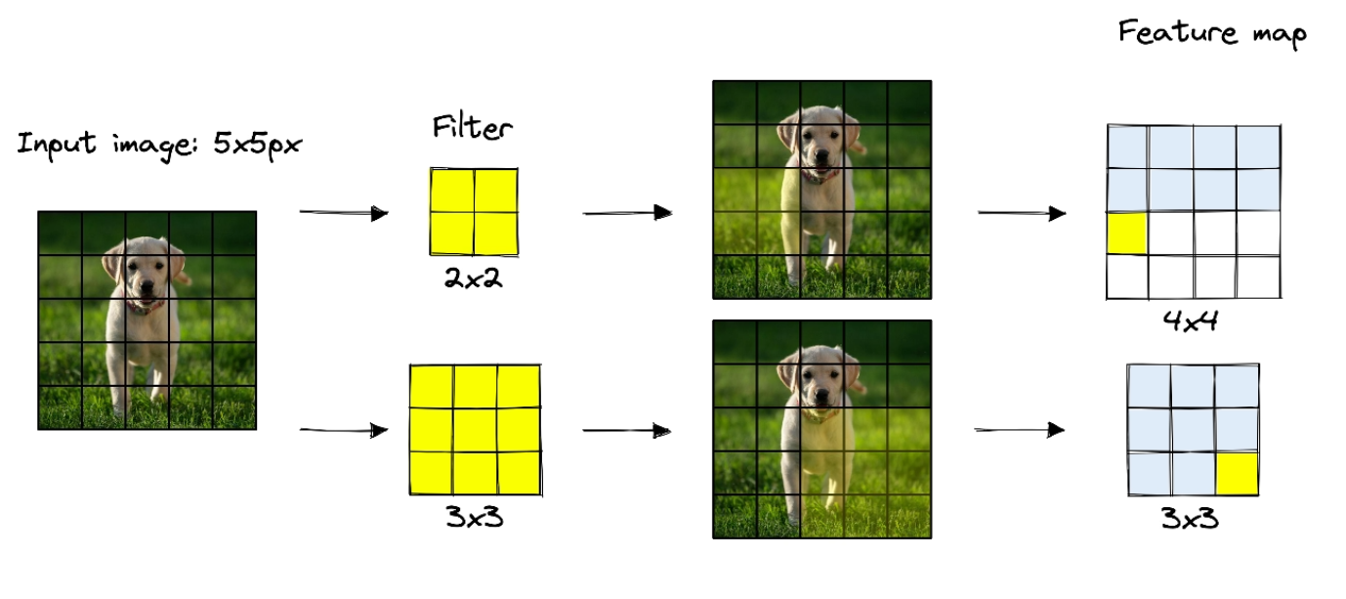
Feature/Activation Map

Slide 15
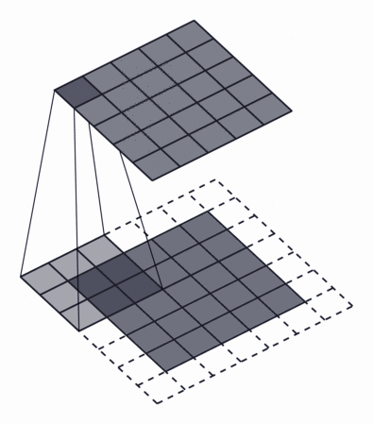
Padding
Padding is often necessary when the kernel extends beyond the activation map.
Padding conserves data at the borders of activation maps, which leads to better performance, and it can help preserve the input's spatial size, which allows an architecture designer to build deeper, higher performing networks.
There exist many padding techniques, but the most commonly used approach is zero-padding because of its performance, simplicity, and computational efficiency.
The technique involves adding zeros symmetrically around the edges of an input.

Slide 16
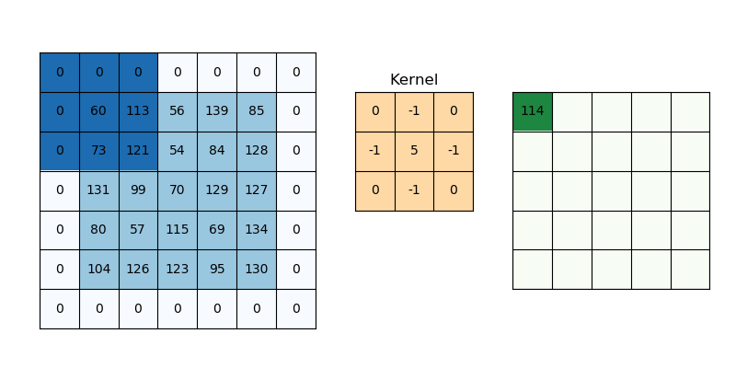
Padding
It is a term used in convolutional neural networks to describe how many pixels are added to an image when it is processed by the CNN kernel.

Slide 17
Strides
Stride indicates how many pixels the kernel should be shifted over at a time.The impact stride has on a CNN is similar to kernel size.
As stride is decreased, more features are learned because more data is extracted, which also leads to larger output layers.
On the contrary, as stride is increased, this leads to more limited feature extraction and smaller output layer dimensions.
Stride determines how the filter convolves over the input matrix, i.e. how many pixels shift.
When stride is set to 1, the filter moves across one pixel at a time, and when the stride is set to 2, the filter moves across two pixels at a time.
The smaller the stride value, the smaller the output, and vice versa.

Slide 18
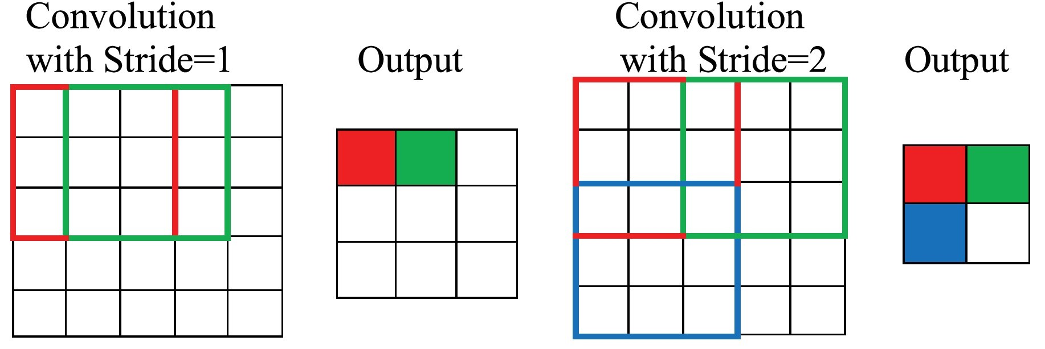
Strides

Slide 19
Need for Padding and Strides
There are some surprising effects of image compression, and one that we must be careful of is the filter’s interaction with the border areas of an input layer.
The border effects on small images can result in a rapid loss of information for images containing too little information.
To avoid this, we either reduce compression using the previously discussed techniques (filter size and stride) or add padding.

Slide 20
Need for Padding and Strides
Adding a set of zero-value pixels around the image allows us to limit or prevent compression between layers.
For example, the operation without padding causes compression of 10x10 pixels into 8x8 pixels. With padding, no compression occurs (a 10x10 feature map is output). TK 10x10??
For larger images, compression is less likely to cause problems. However, when working with smaller images, padding acts as an easy and effective remedy to border effects,

Slide 21
Pooling Layers
Similar to the Convolutional Layer, the Pooling layer is responsible for reducing the spatial size of the Convolved Feature.
This is to decrease the computational power required to process the data by reducing the dimensions.
There are two types of pooling average pooling and max pooling.
Pooling layers are a downsampling method that compresses information from one layer into a smaller space in the next layer.
An effect of pooling is that information across several pixels is compressed into a single activation, essentially “smoothing out” variations across groups (or patches) of pixels.

Slide 22
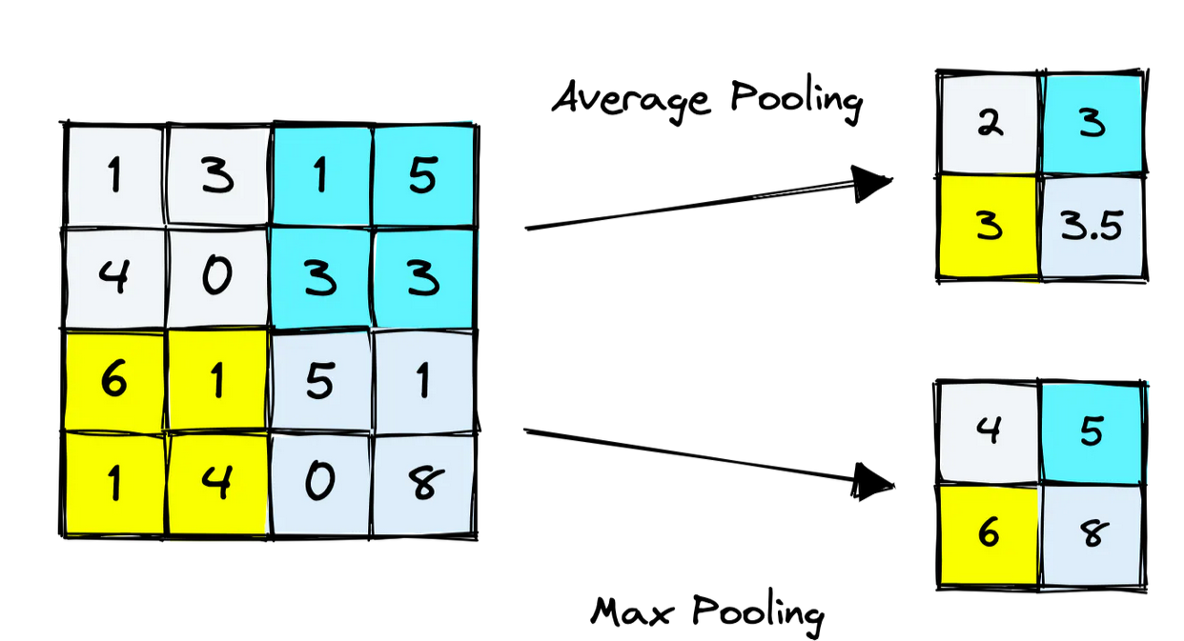
Pooling Layer
The two most common pooling methods are average pooling and max pooling. Average pooling takes the average of activations in the window, whereas max pooling takes their maximum value.

Slide 23

Max Pooling
we do in Max Pooling is we find the maximum value of a pixel from a portion of the image covered by the kernel. Max Pooling also performs as a Noise Suppressant.
It discards the noisy activations altogether and also performs de-noising along with dimensionality reduction.

Slide 24
Average Pooling
Average Pooling returns the average of all the values from the portion of the image covered by the Kernel.
Average Pooling simply performs dimensionality reduction as a noise-suppressing mechanism.
Hence, we can say that Max Pooling performs a lot better than Average Pooling.

Slide 25
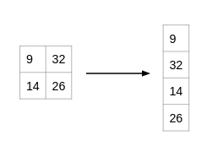
Flattening Layer
This layer converts a three-dimensional layer in the network into a one-dimensional vector to fit the input of a fully-connected layer for classification.
For example, a 5x5x2 tensor would be converted into a vector of size 50. The previous convolutional layers of the network extracted the features from the input image, but now it is time to classify the features.
We use the softmax function to classify these features, which requires a 1-dimensional input.
This is why the flatten layer is necessary

Slide 26
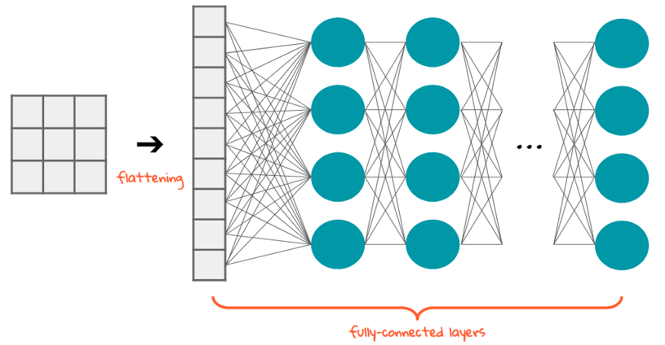
Flattening

Slide 27
Dropout Layer
The main idea behind using dropout is simple, to avoid overfitting.
The most popular regularization method is used in Neural networks.
Even if we are using a different model and achieve around 90% of accuracy, by using dropout we can able to achieve around 92% of accuracy.
During training time, at each iteration, a neuron is temporarily “dropped” or disabled with probability p. This means all the inputs and outputs to this neuron will be disabled at the current iteration.

Slide 28
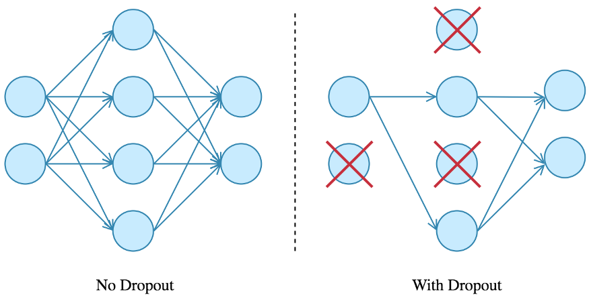
Dropout Layer
The dropped-out neurons are resampled with probability p at every training step, so a dropped-out neuron at one step can be active at the next one.
The hyperparameter p is called the dropout rate and it’s typically a number around 0.5, corresponding to 50% of the neurons being dropped out.

Slide 29
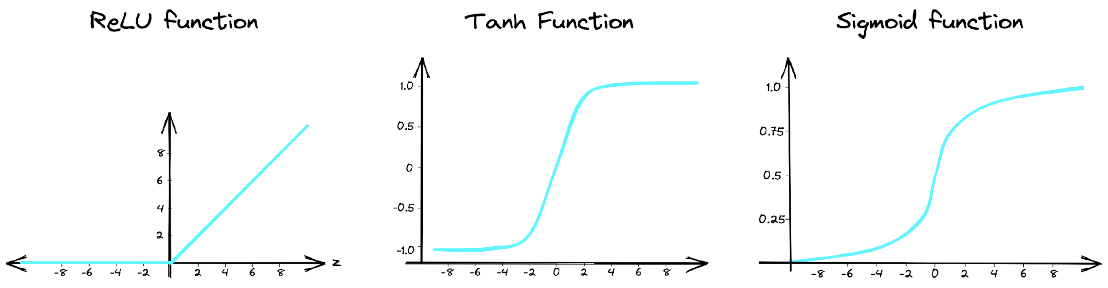
Activation Functions
Activation functions are a common feature in every type of neural network.
They add non-linearity to networks, enabling the representation of more complex patterns.

Slide 30
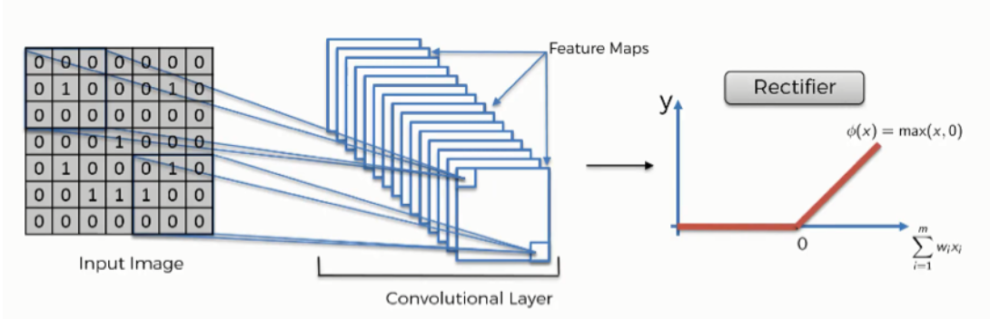
ReLU
The rectified linear activation function, or ReLU for short, is a piecewise linear function that, if the input is positive, outputs the input directly; else, it outputs zero.
Because a model that utilizes it is quicker to train and generally produces higher performance, it has become the default activation function for many types of neural networks.

Slide 31
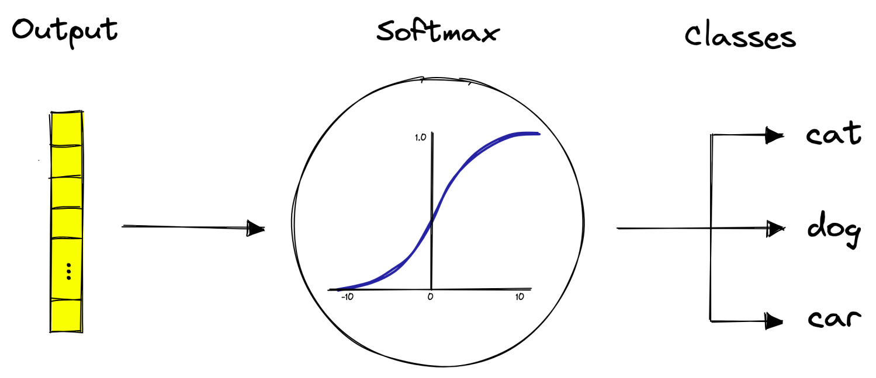
Softmax
Classifiers tend to apply a softmax activation function that creates a probability distribution across the final output nodes — where each node represents a specific class.

Slide 32
Choosing the right Activation Function
Now that we have seen so many activation functions, we need some logic / heuristics to know which activation function should be used in which situation. Good or bad – there is no rule of thumb.
However depending upon the properties of the problem we might be able to make a better choice for easy and quicker convergence of the network.
Sigmoid functions and their combinations generally work better in the case of classifiers
Sigmoids and tanh functions are sometimes avoided due to the vanishing gradient problem

Slide 33
Choosing the right Activation Function
ReLU function is a general activation function and is used in most cases these days
If we encounter a case of dead neurons in our networks the leaky ReLU function is the best choice
Always keep in mind that ReLU function should only be used in the hidden layers
As a rule of thumb, you can begin with using ReLU function and then move over to other activation functions in case ReLU doesn’t provide with optimum results

Slide 34
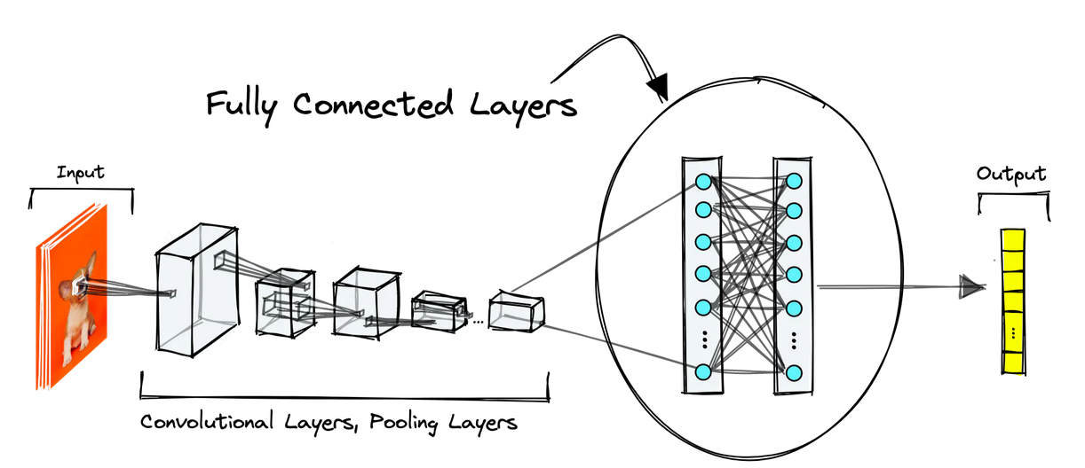
Fully Connected Layers
Fully connected linear layers are another common feature of CNNs.
They are neural networks in their most stripped-down form; the dot product between inputs XX and layer weights WW with a bias term bb and activation function.

Slide 35
CNN Summary
1. Provide the data/dataset (any format of data) into the convolution layer
2. Take convolution with featured kernel/filters
3. Next apply a layer, Pooling for reducing the dimensions
4 If you need a deeper understanding add these layers repeatedly.
5. Next step is to apply to flatten for a single column
6. Feed into a fully connected layer
7. Now lastly train the model with appropriate metrics and optimizer

Slide 36
CNN – Different Architecture Models
Before getting deeper into the models, let’s understand some basic terminologies,
1. Wider – means more feature maps (filters) in the convolutional layers
2. Deeper – means more convolutional layers
3. High Resolution – means that it processes input images with larger width and depth (spatial resolutions). That way the produced feature maps will have a higher spatial dimensions.

Slide 37
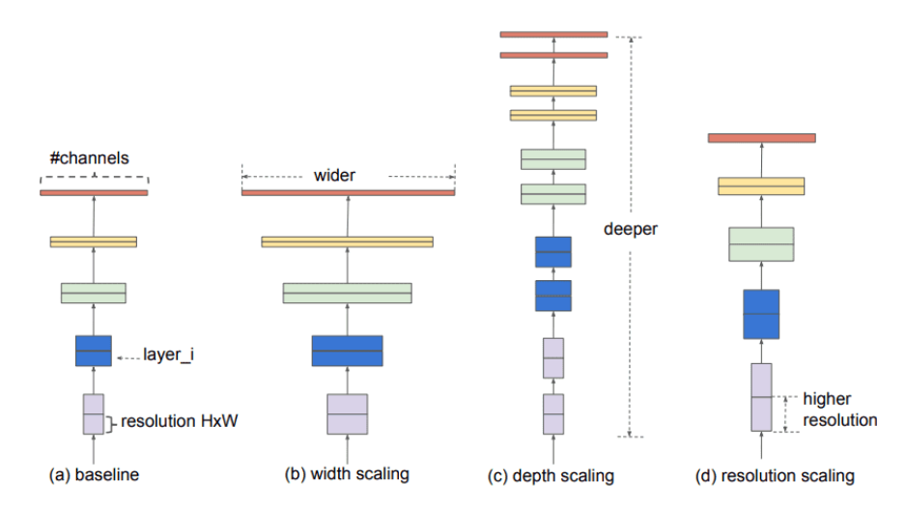
CNN – Different Architecture Models

Slide 38
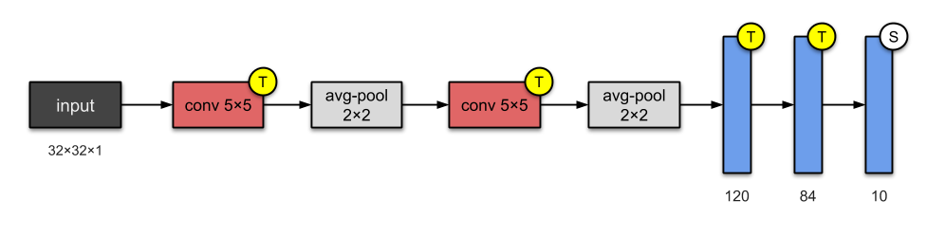
LeNet-5
(2 – Convolution layer & 3 – Fully Connected layers) – 5 layers

Slide 39
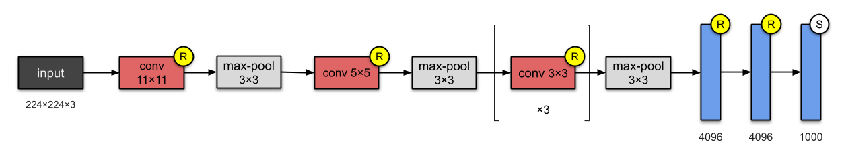
AlexNet
(5 – Convolution layer & 3 – Fully Connected layers) – 8 layers

Slide 40
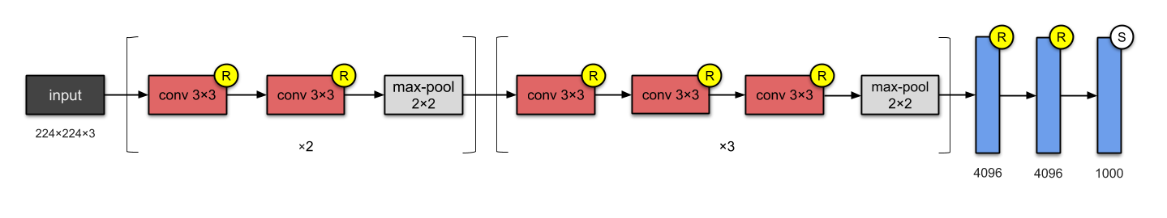
VGG 16
(13 – Convolution layer & 3 – Fully Connected layers) – 16 layers

Slide 41
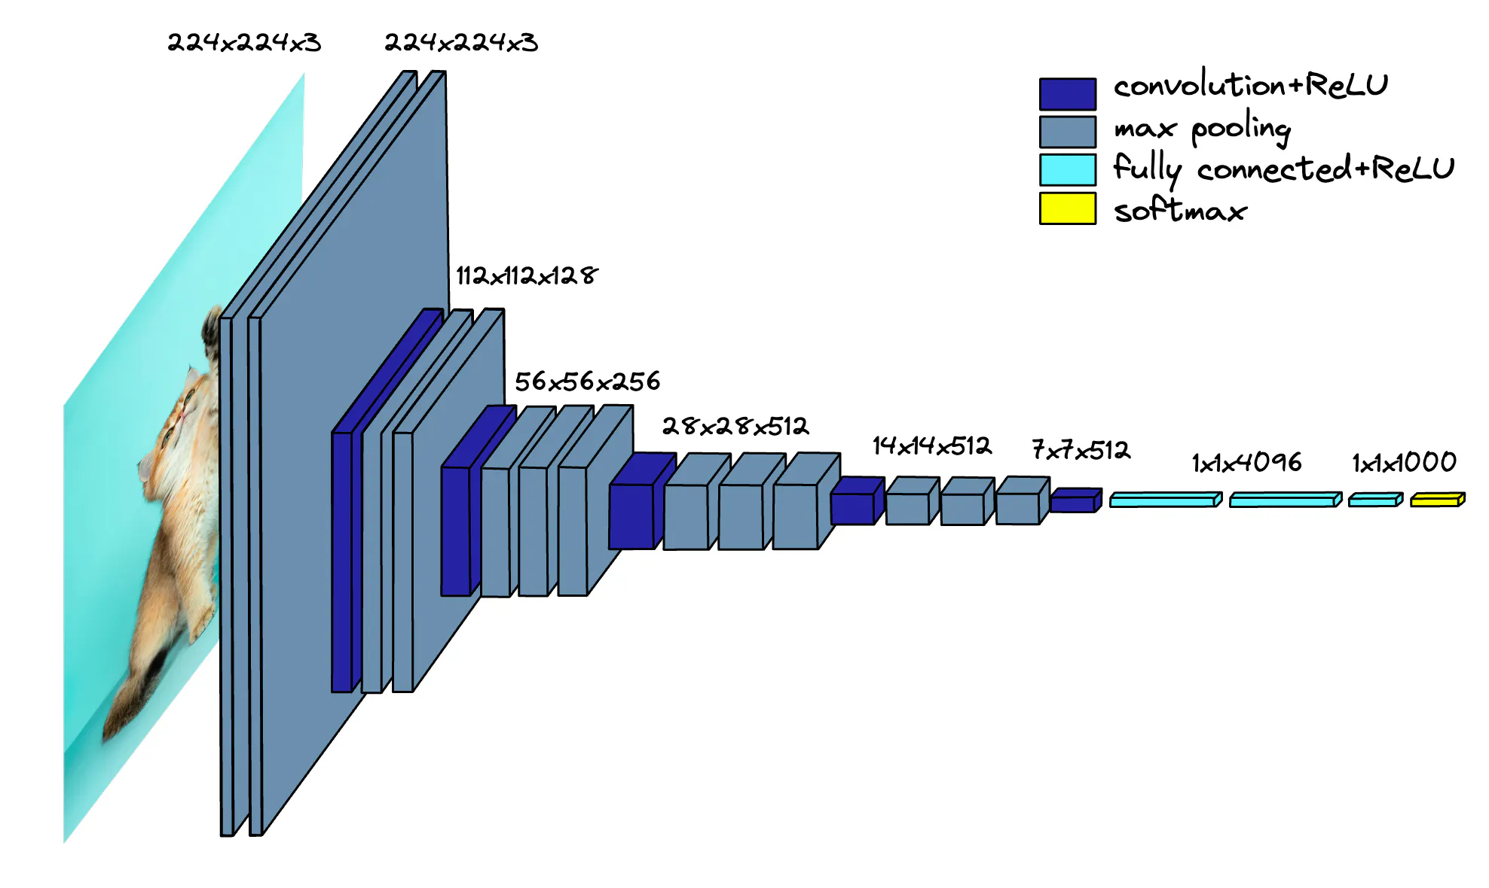
VGG Net

Slide 42
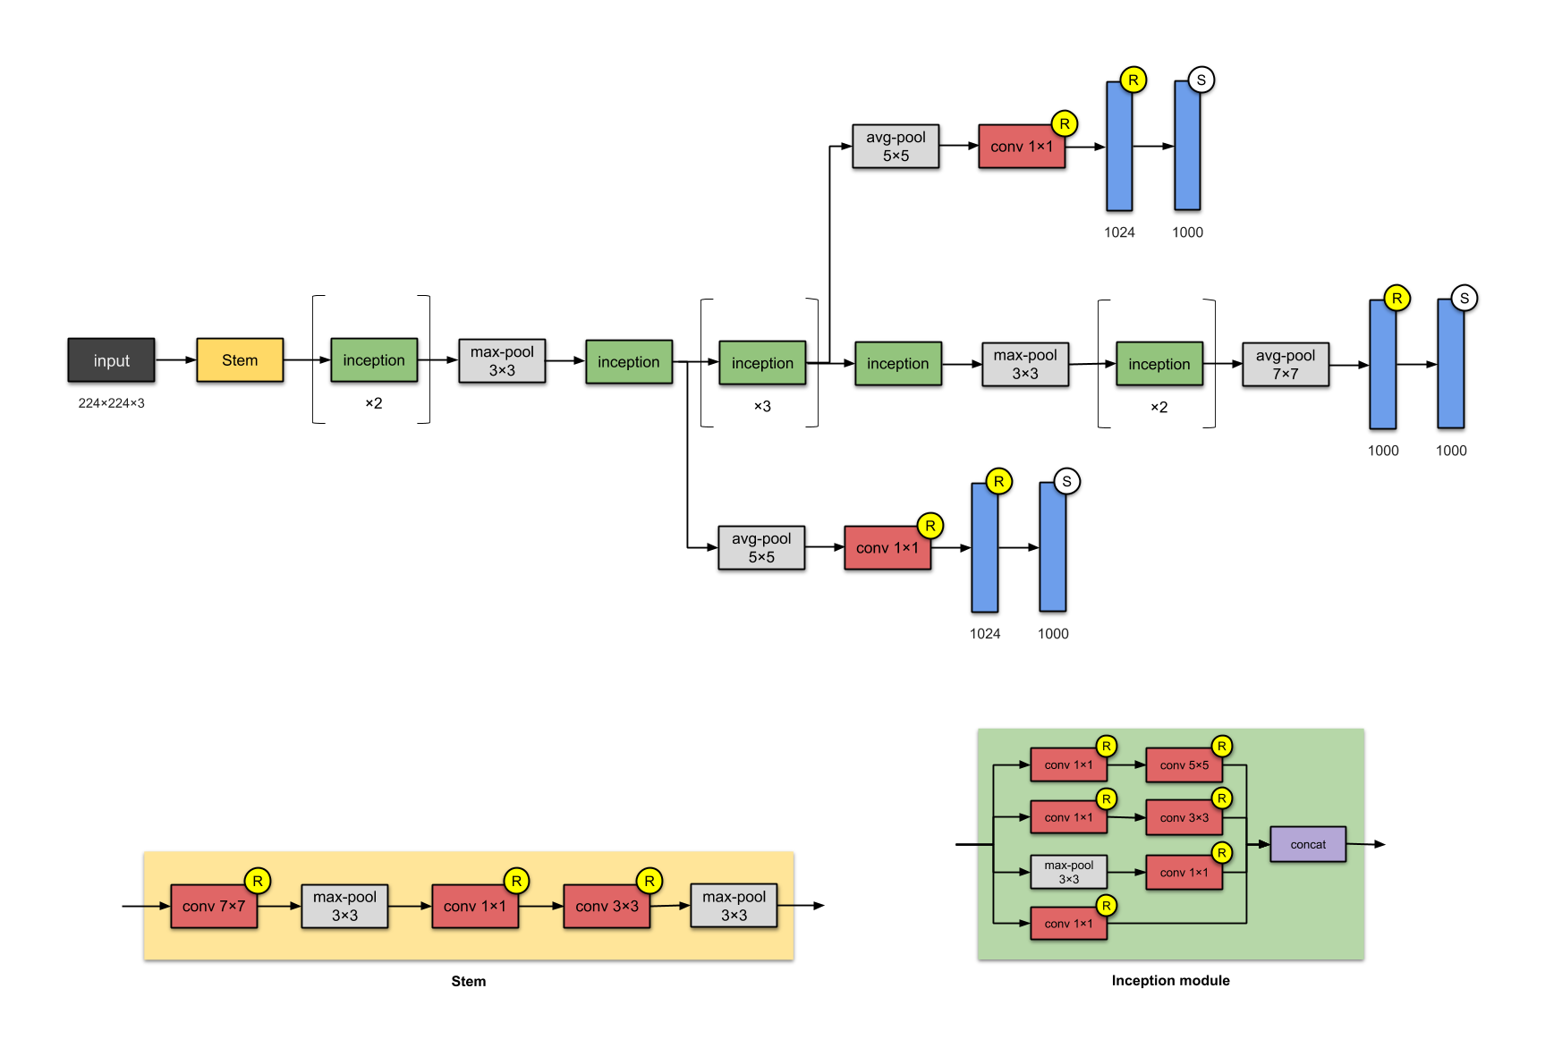
Inception V1 – 22 layers

Slide 43
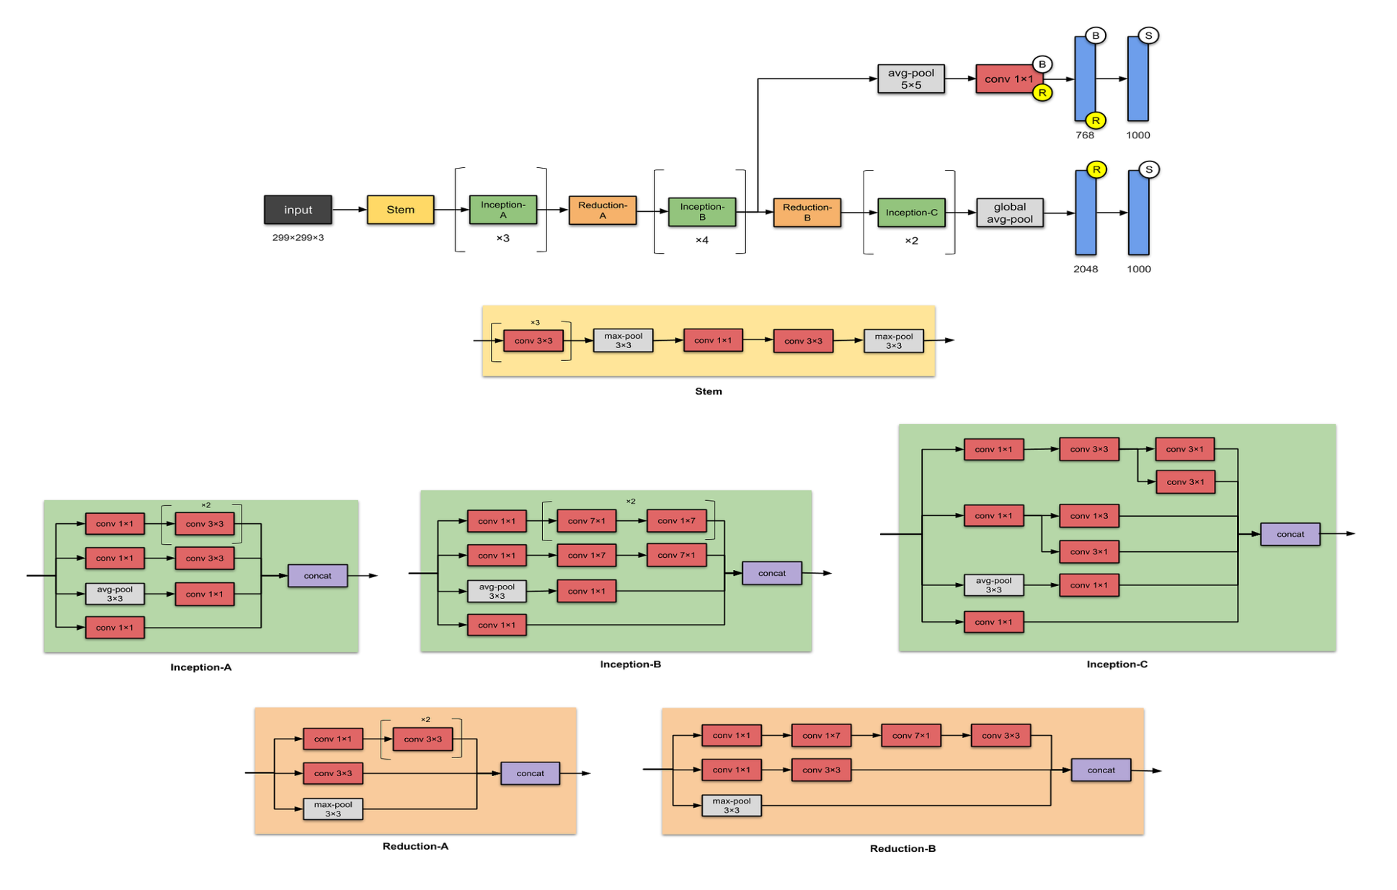
Inception V3

Slide 44
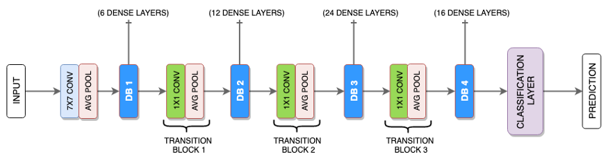
Dense Net

Slide 45
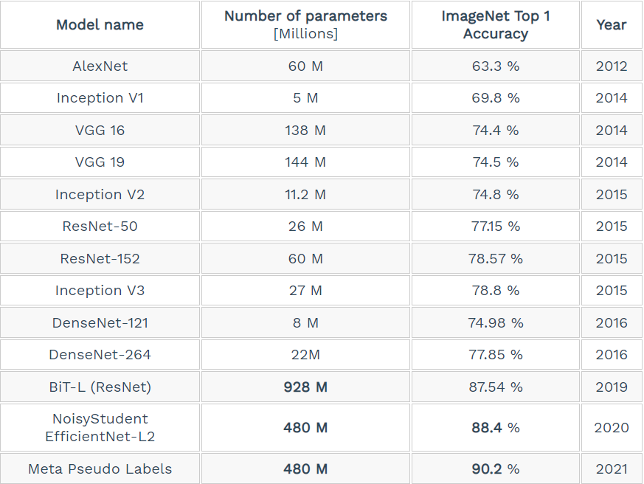
Compare Models

Slide 46
Advantages of CNN
1. Automatically detects important features without any human supervision
2. Computationally efficient (Convolution and Pooling process performs parameter sharing)
3. Weight Sharing
4. High Statistical efficiency
5. Translational Invariance

Slide 47
Disadvantages of CNN
1. Classification of Images with different Positions (different angles, different backgrounds, different lighting conditions)
2. Adversarial examples (CNN takes an image along with some noise it recognizes the image as a completely different image whereas the human visual system will identify it as the same image with the noise)
3. Coordinate Frame (Coordinate frame is basically a mental model which keeps track of the orientation and different features of an object)
4. Slower due to functions like Maxpool
5. As several layers are functional then the training process takes lots of time if our CPU doesn’t have a good GPU

Slide 48
Applications of CNN
1. Decoding Facial Recognition
2. Analysing Documents
3. Classification
4. Segmentation (Organs or any anatomical structures is a fundamental Image Processing technique for Medical Image Analysis)
5. Detection (Common task for Radiologist is to detect abnormalities with Medical Images)

Slide 49
THANK YOU

